Slide 2
NetDevOps: Automation on Bare Metal Switches
Intros
What is Open Networking? (Kevin)
Open hardware, ONIE, APD
Automation (Kevin)
Ansible playbooks, puppet manifests, etc for network configuration
CI/CD in a Network context (Russ)
Full stack testing
Demo (Russ)

Slide 3
CI/CD in a Network Context
CI/CD was originally intended for software
CI/CD evolves and matures into DevOps
Network Configuration is now code
Desired outcomes for NetDevOps:
Raise quality and value of the Infrastructure AND the services on top of it
Spend less time on unplanned work & rework [1]
Stop creating snowflakes
Automate repetitive tasks
All changes go through Code Control
Operational Improvement with NetDevOps
Capacity Planning
Automate troubleshooting steps / information gathering
Automate maintenance events and engaging “Smart Hands”
[1] “2016 State of DevOps” Report from Puppet

Slide 4
artisan|ˈärtəzən| noun a person or company that makes a high-quality or distinctive product in small quantities, usually by hand or using traditional methods.
“Artisan working meticulously on a wooden sculpture” by Piseth1 is licensed under CC-BY-SA-3.0
Notes:
Artisanal Networking is the time-consuming, traditional method of managing networks. We’ve been doing this device-by-device configuration method for decades and it needs to stop!
No more Artisanal Networking

Slide 5
No more Excel templating for network devices!
“Arithmetical machine with neperian cylinders” by René Grillet is licensed under CC-BY-SA-3.0
Notes:
Excel Templating

Slide 6
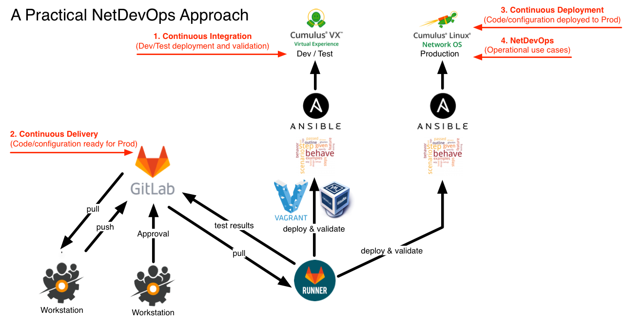

Slide 7
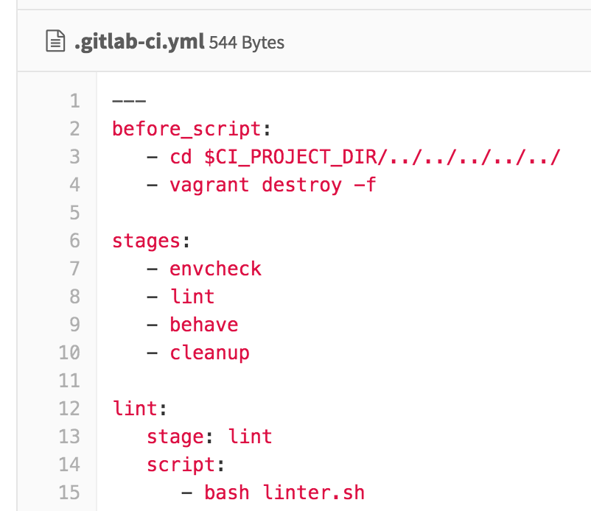
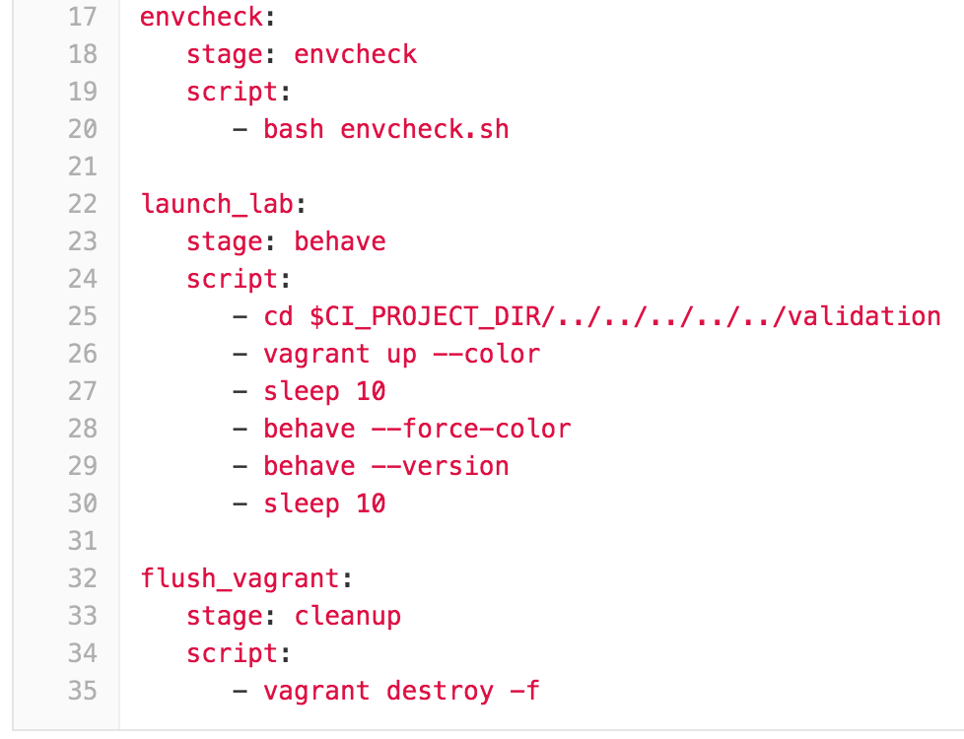
GitLab CI Anatomy

Slide 8
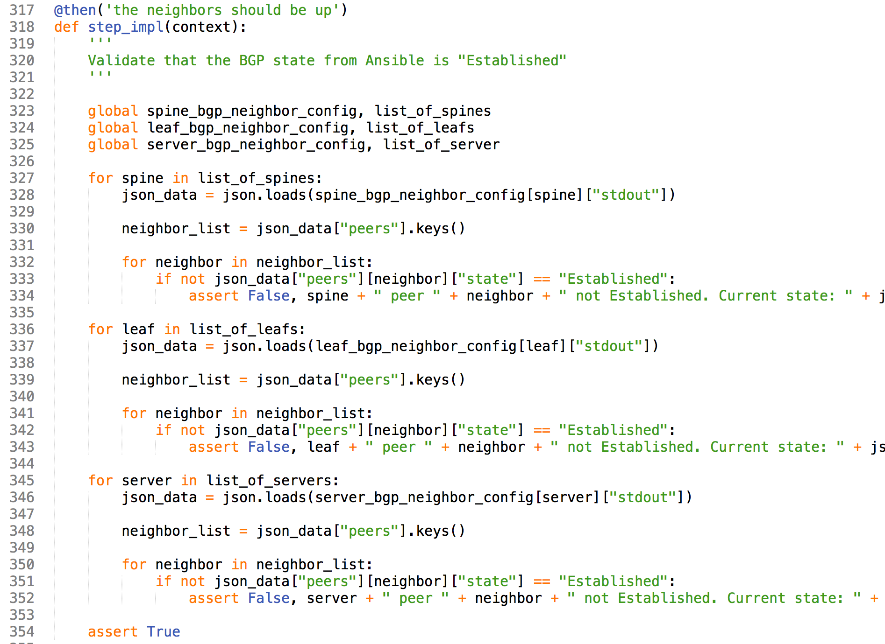
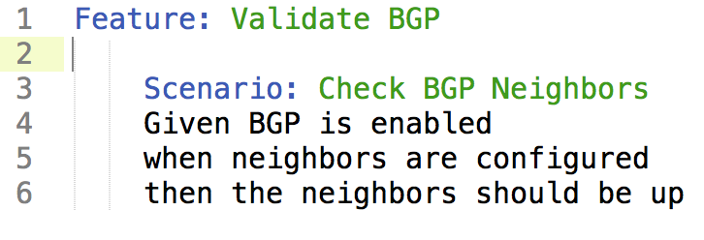
Behave
Backing Python code
./validation/steps/bgp.py
Behavior-Driven Development (BDD)
Natural Language Tests
“feature” code
./validation/bgp.feature

Slide 9
Full Stack Testing
NETWORK
CONFIGURATION
IAAS
CONFIGURATION
SERVICE
CONFIGURATION
STP (or not)
Keystone
winbind
LACP / MLAG
Horizon
Base OS Settings
BGP
Object Storage
splunk
Switches
HEAT
haproxy
Ansible
Subnets
Puppet
Cinder
Chef
syslogd
VLANs
Glance
ruby
Switch Ports
Neutron
Zabbix
VXLAN / Overlay
Nova
MySQL
Routers
Midokura
apache2
Behave
Tempest
Test Kitchen
GitLab CI Runner
Notes:
Snowflakes
Excel Templating
Proprietary Network OS
Limited Test / Validation / Review
Limited Configuration Control
Verification with Ping & Traceroute

Slide 10
Demo
GitLab project overview
Repo, Pipelines, and Runners
GitLab Runner overview
Good change: Update MOTD
Bad change: Routing typo / lint failure

Slide 11
